Slide 1
“The Office” Twitter quote bot
Ethan Brinks

Slide 2
Background
Videos previously seen on YouTube
Data collection for conclusion
Practicality
Automation
Visualization

Slide 3
Goals for Bot
Tweet a quote from “The Office” on the hour every hour
Reply to mentions
Follow back people that follow the bot

Slide 4
Pre-coding
Modules that need to be imported
Tweepy
Time
Random
How the API works
How to create a Twitter developer account

Slide 5
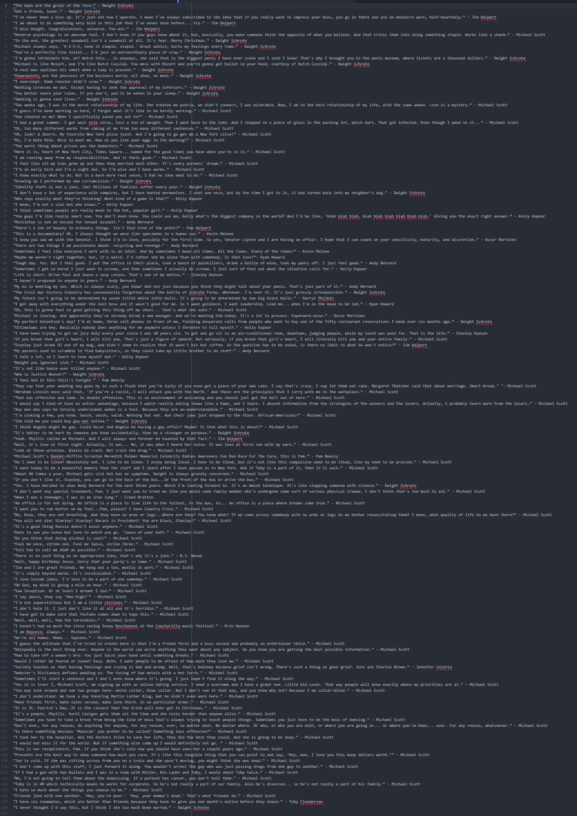
Backend
Text file of formatted quotes

Slide 6
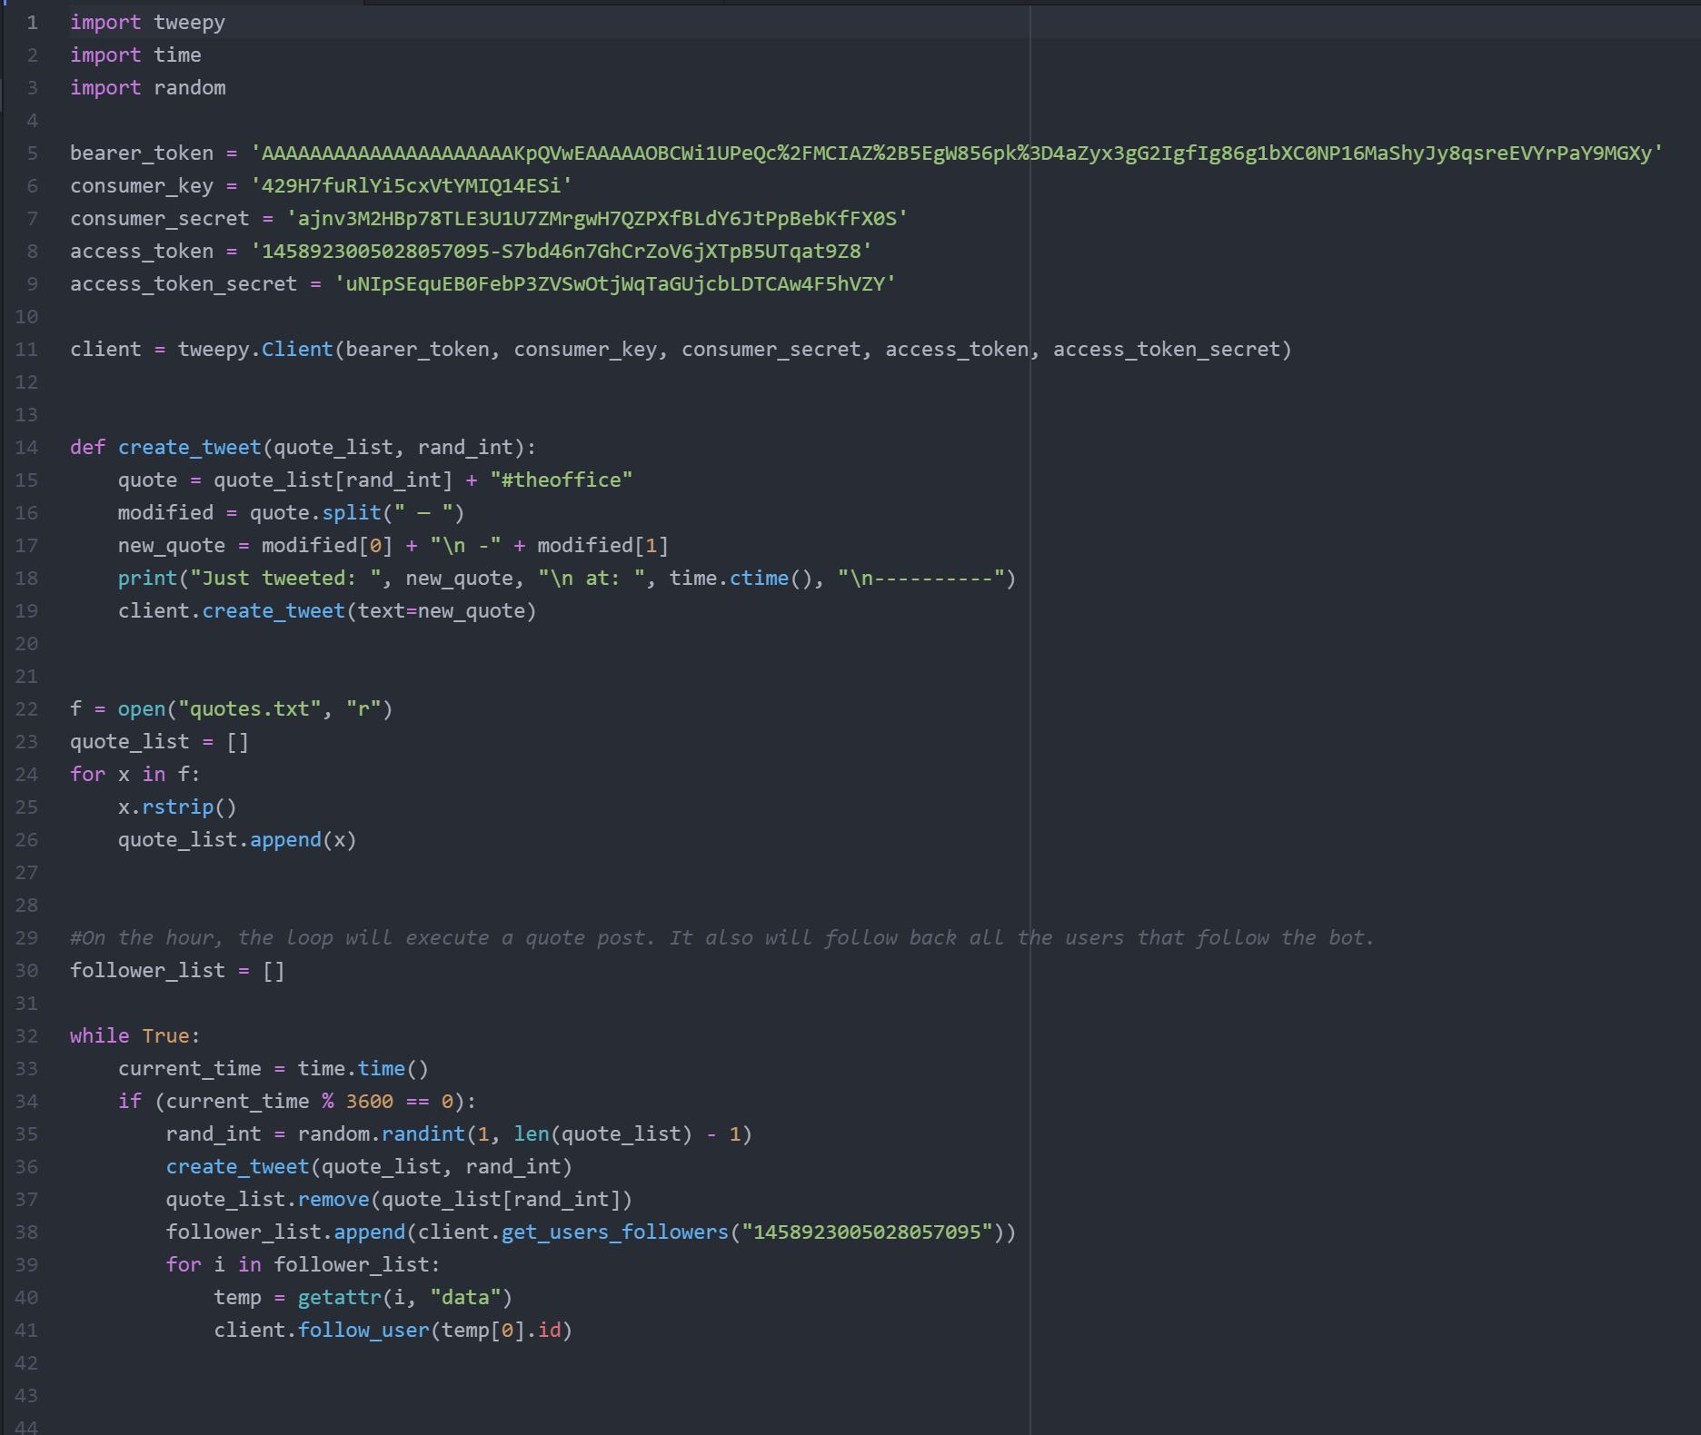
Backend
Text file of formatted quotes
Python file coded in Atom text editor
4 “sections” of the program

Slide 7
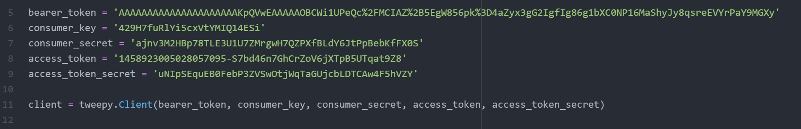
Connection

Slide 8
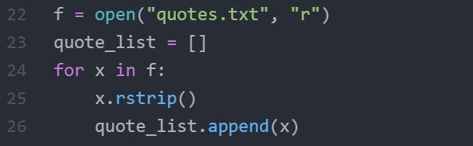
File Open

Slide 9
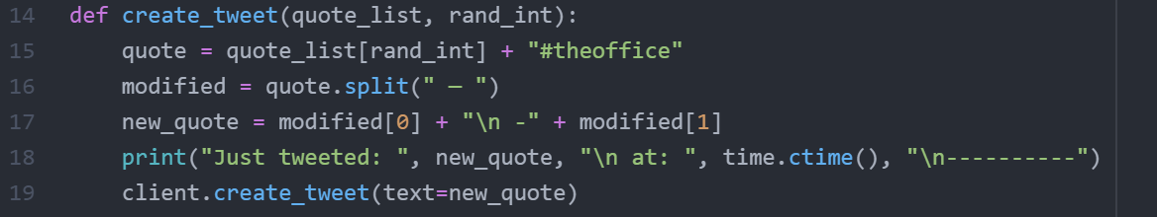
Tweet Action

Slide 10
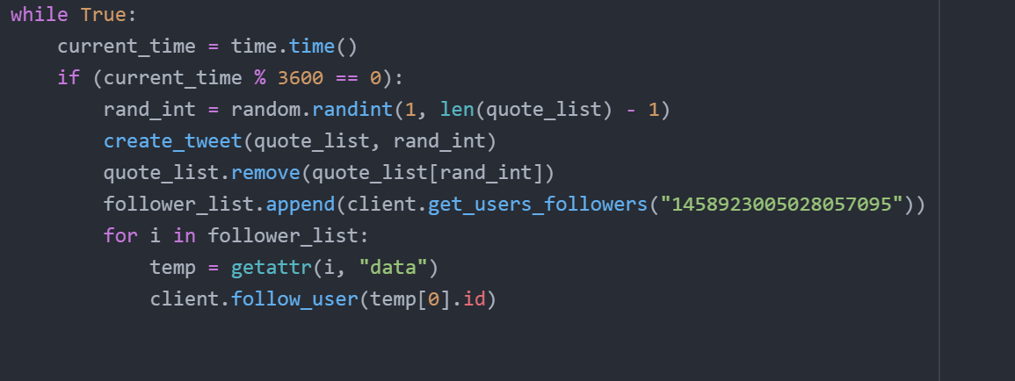
Constant Loop and Follow Back Action

Slide 11
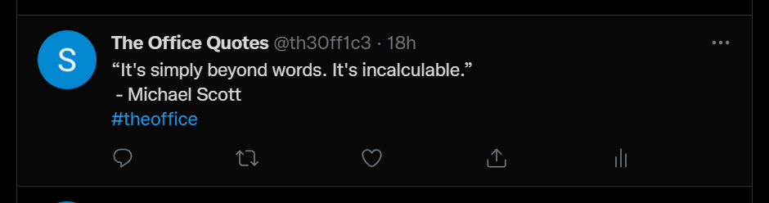
Data
First tweet executed at 9:00 PM on December 1
Last tweet executed at 6:00 PM on December 4
Total of 57 tweets
Most viewed tweet was 23 views
Least viewed was 3 views
Only 1 like across all tweets
No naturally generated follows

Slide 12
Issues
Twitter API v2
Lack of updated documentation
Not able to reply to mentions due to lack of documentation
Large amount of time spent troubleshooting
Quotes.txt file contained — instead of - which messed up .split(“ - ”)
Too many requests in a certain time frame

Slide 13
Next Time
Expand functionality
Respond to mentions
Analyze trending hashtags
etc.
Larger list of quotes
Make quote list regenerate once it has run out

Slide 14
Sources
https://stackoverflow.com/questions/70061685/can-a-tweeter-bot-post-tweets-or-quotes-via-v2-api-essential-access
How to connect to bot because documentation was outdated
https://docs.tweepy.org/en/stable/
Official Tweepy documentation
https://www.programiz.com/python-programming/time
How to use the time module
https://quotecatalog.com/quotes/tv/the-office
List of The Office quotes
https://auth0.com/blog/how-to-make-a-twitter-bot-in-python-using-tweepy/
How to go through creating a Twitter developer account

Slide 15
Questions?

